Slide 1
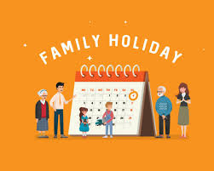
Finding Holiday Harmony: Balancing Play and Plans for Young Children
Coffee and Conversation
December 5, 2024
Ellie and Chriss

Slide 2
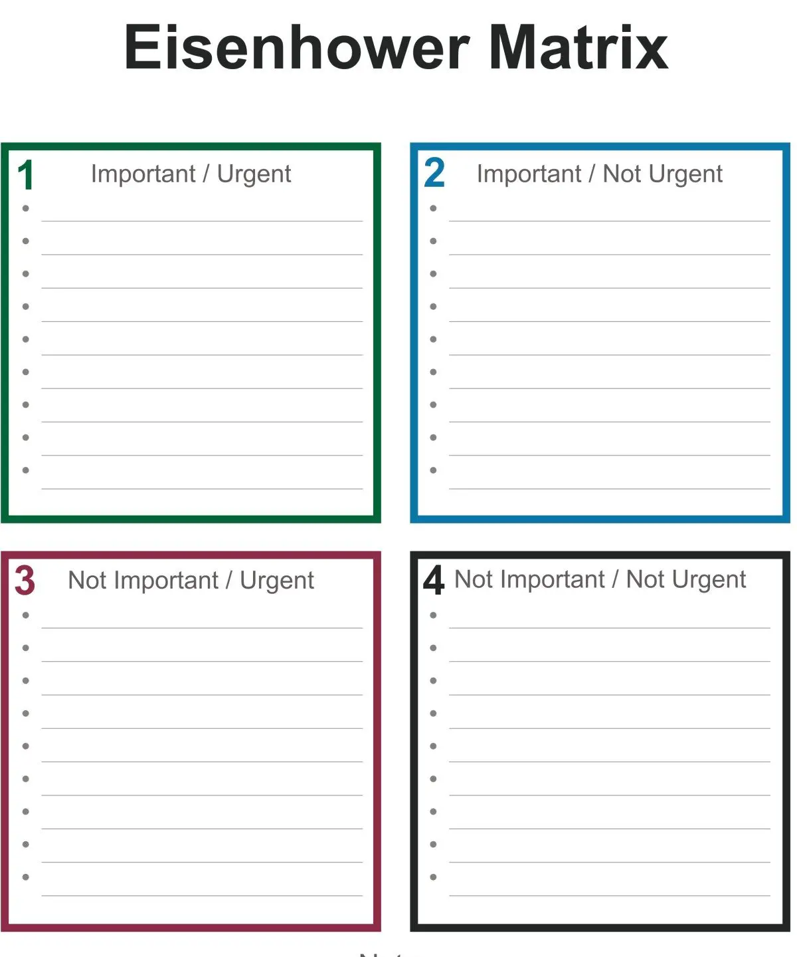
Look ahead and consider what is important / your values
Holidays and time with family can be wonderful, celebratory and important and can also be exhausting and evoke strong emotions.
If at all possible, look at your schedule and plan and think about different needs within your family. Consider asking for changes if needed, holding boundaries.
Consider your own and your children's social battery.

Slide 3
Responding to possible overwhelm
Give children advance notice and talk about schedule, number of people
Make time visible – use calendar, x number of sleeps, timer
Provide a calm space or refuge during busy parties or gatherings – if going to someone else's home, bring along items that are helpful, colouring pages, books, small toys, weighted blanket
Consider saying no to some invitations.

Slide 4
Gratitude and gatherings
Help children understand the 'social script' for receiving gifts, it is okay to not love everything you receive, and you can still say thank you and tell your true feelings in a later (private) moment.
In gatherings with multi-age children consider having a job jar or even activity jar, so children can be engaged in helping or finding activities to do.
It may be helpful to have your children contribute to decisions about what is most important to them in terms of activities or outings.

